Slide 1
MISSOURI NATIONAL GUARD HUMAN RESOURCES
New Hire Orientation

Slide 2
Overview
Programs and services offered.
Important information and deadlines regarding benefit programs.
Guidance in completing the basic New Hire forms.
Covering all eligible employee benefits.

Slide 3
HR Contacts
Joint Force Head Quarters:
(573) 638-9500
Leigh Ann Smith Ext: 39892 Tara Wilson Ext: 37497
Jacqui Conatser Ext: 37496 Chelsea Kirchner Ext: 37746
Katelyn McAllister Ext: 39520 Jaelyn Smith Ext. 37494
139th Airlift Wing
MSgt Jordan Rumph DSN: 236-3507 SSgt Amber Murphy DSN: 236-3507
131st Bomb Wing
Michael Guanella: (660) 687-7461 TSgt Samantha Harris: (314) 527-8909
AVCRAD TASMG
SFC Ruthanne Schneider Ext: 18428 SFC Aaron Semsch Ext: 18019

Slide 4
Director of Information Management (J6)
Command Cyber Readiness Inspection (CCRI)
Performed every 4 years
MONG Logon account
SAAR/DD2875, AUP, and IAA Exam Certificate
DoD Cyber Awareness Challenge Training (JKO or Ft. Gordon)
J6 Self Help – (GKN connection)
Outlook PSTs
How Tos
Internet Home Page
Outlook Web App (OWA)
Automated Time Attendance (ATAAPS)
Notes:
1) CAC – Never leave it behind! Never allow someone else to open access to your computer under your CAC (you must monitor what they do, where they go, under your profile)
2) If initial set-up of account, Submit 3 items. MANDATORY to renew account yearly: take IA exam and submit cert with updated MO AUP.
Other Frequently Viewed on G6 Self Help:
DoD Guest WIFI Details
Frequently Q&A
Updating Launchpad
Scheduling DA photos
AUP doc
Policies and Procedures
4) OWA – accessing e-mail when away from computer without taking the lengthy time of building a profile on the specific computer logged in to
MONG SharePoint:
MYSITE – use instead of saving everything to desktop or C:/ or MyDocuments (10 GB available)
When we go to Windows 10…backing up documents on your system is YOUR RESPONSIBILITY

Slide 5
EO/EEO Program
Protected Groups:
Race, Color, Religion, Sex-Gender (including pregnancy, gender identity and sexual orientation), National Origin, Genetic Information or Sexual Harassment)
Sexual Harassment:
TAG Policy Memo #20-16-1
(Commanders are to notify the first General Officer in chain of command of all sexual harassment allegations within 24 hours)
Complaint Process:
EO (Military) - File within 180 days of alleged event
EEO (Title 32/Title 5) - File within 45 days of alleged event
EO/EEO Office Contact Information:
573-638-9689

Slide 6
Employee Assistance Program
Relationship Issues
Crisis Management
Addictions
Grief Counseling
For (Title 32 Dual Status and Title 5 ) Contracted Provider Magellan:
Army EAP: 866-580-9046 Army Magellan Ascend
Air Force EAP: 866-580-9078 Air Force Magellan Ascend
(6 visits per family member, per event, per year)
For Military (AGR and Dual Status Technicians)
Military One Source:
www.MilitaryOneSource.com or 1-800-342-9647
(12 visits per family member, per event, per year)
Legal or Financial Concerns

Slide 7
MyBiz+
Retrieve current pay, position, and personal data
Track Performance Appraisals
Retrieve prior year Performance Appraisals
Retrieve SF50’s
Civilian Career Brief
Update Supervisor/ Update My Team (for supervisors)
Request Employment Verification
Update Contact Information
For questions, please contact:
Samantha Baugh Ext. 37493 or Nicholas Garrard Ext. 39690.

Slide 8
Electronic Official Personnel File (eOPF)
The Electronic Official Personnel File (eOPF) is a file containing Federal civilian employee’s personnel records throughout their career.
Examples:
SF50s
Benefits Forms
DD214s/Orders
To access your eOPF visit:
https://eopf.opm.gov/nationalguard/

Slide 9
Termination of Bonus Student Loan Repayment Program
The following is a list of programs offered to dual status technicians on board for 179 days or less:
Federal Bonus Program
Student Loan Repayment Program
GI-Bill
If your technician appointment is longer than 179 days, you are no longer eligible for these programs. Once you reach 180 days, your student loan and/or bonus will be terminated without recoupment of pay.

Slide 10
Termination of Bonus (Cont.)
GI Bill Info: Handouts and Forms - Education and Training (va.gov)
Missouri National Guard > Programs > Education and Incentives (ngb.mil)
Home | Federal Student Aid
For more information contact:
ARMY: SSG Malloy Ext: 37690, SGT Kothe Ext: 37170 or SFC Klempke Ext: 37051
AIR: 157th Jefferson Barracks, St. Louis, MO -Recruiters
MSgt Joseph J. Swanson joseph.swanson.2@us.af.mil &
TSgt David Upchurch david.upchurch.1@us.af.mil
DSN: 824-8006 Comm: (314) 527-8006
131st BW, Whiteman AFB, MO:
MSgt Jarrett Rasmussen -Recruiter Supervisor jarrett.rasmussen@us.af.mil &
TSgt Cody Cox -Recruiter Manager cody.cox.14@us.af.mil
DSN: 975-7420 or 975-5449 or Comm: (660) 687-7420
139th AW, St. Joseph, MO:
MSgt Jason Jones -Retention Office Manager jason.jones.24@us.af.mil
DSN: 356-3339 or Comm: (816) 236-3339
Helpful Links:

Slide 11
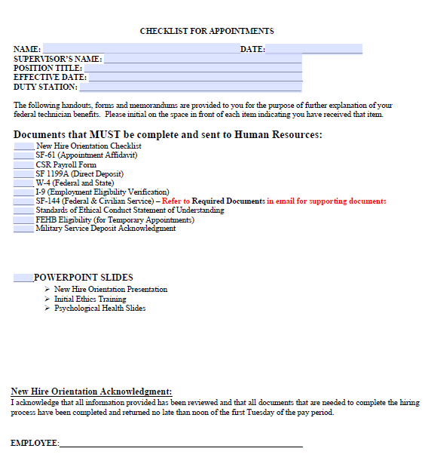
New Hire Packet Checklist

Slide 12
Appointment Affidavits
Department or Agency: Missouri National Guard
Bureau or Division:
Army or Air

Slide 13
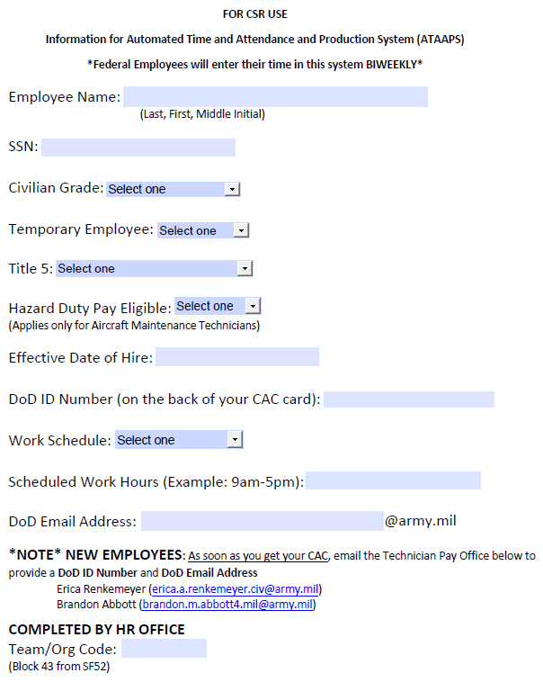
CSR USE FORM
Notes:
NOTE--T5 EMPLOYEES: AS SOON AS YOU GET YOUR CAC, PLEASE EMAIL ERICA RENKEMEYER AND BRANDON ABBOTT (TECH PAY) AND PROVIDE DOD ID NUMBER AND DOD EMAIL ADDRESS.

Slide 14
Direct Deposit
Section 1
A–Name, Address, Telephone Number
C-SSN
D-Type of Account
F-Check Block:
Fed. Salary/Mil Civilian Pay
SIGN
Section 3
Bank Name &
Routing Number

Slide 15
W-4 Forms
Complete Both Forms:
Federal W-4
State MO W-4
Changes can be made anytime during employment by logging on to MyPay: https://mypay.dfas.mil/#/

Slide 16
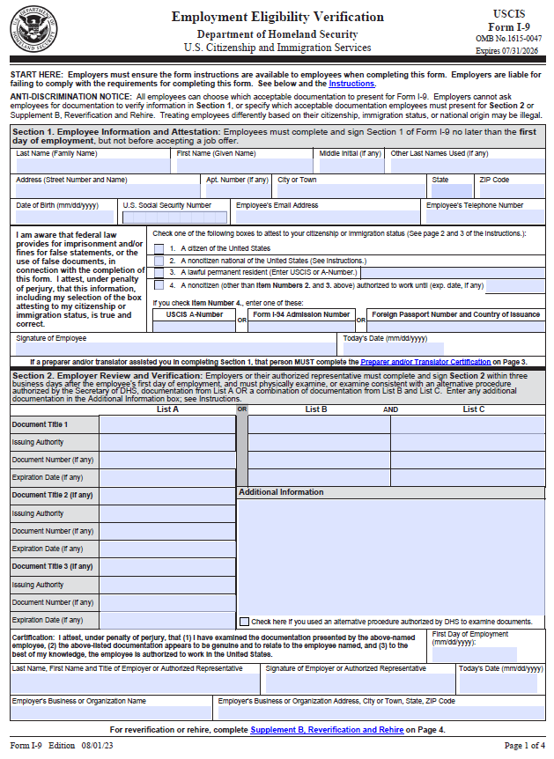
I-9 Form
Section 1 & Section 2
SIGN

Slide 17
I-9 Form
IDs used on the I-9 form must be valid.
We cannot accept expired forms of identification.
You will need 2 forms of ID (one form List B and one from List C), unless you are using a Passport.
List A: List B: List C:
Passport (only) Driver’s License Birth Certificate
or CAC or SSN Card
Please do not fill out the employer or authorized representative information. Our Office will complete this section once we have received your identification documents.

Slide 18
Prior Federal Service
Federal Civilian Service
Examples:
Post Office
Social Security Office
VA
Temp Appt
Service Computation Date (SCD) is calculated based on valid service times documented on the SF144. This will affect your leave accrual along with retirement and retention status in case of a reduction-in-force.
Title 10 Active-Duty Military Examples:
Basic Training
AIT
OCCONUS
Deployments
Do not include if you do not have supporting documentation (DD214s)

Slide 19
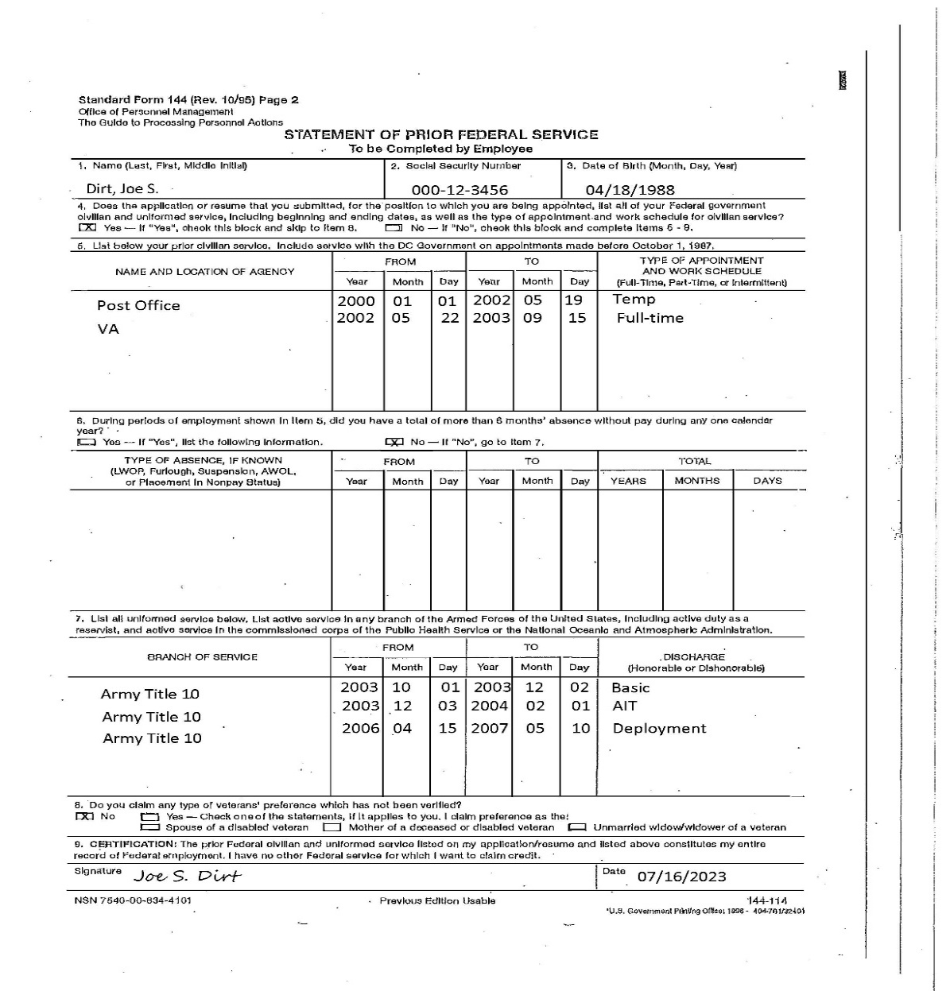
SF144 Example

Slide 20
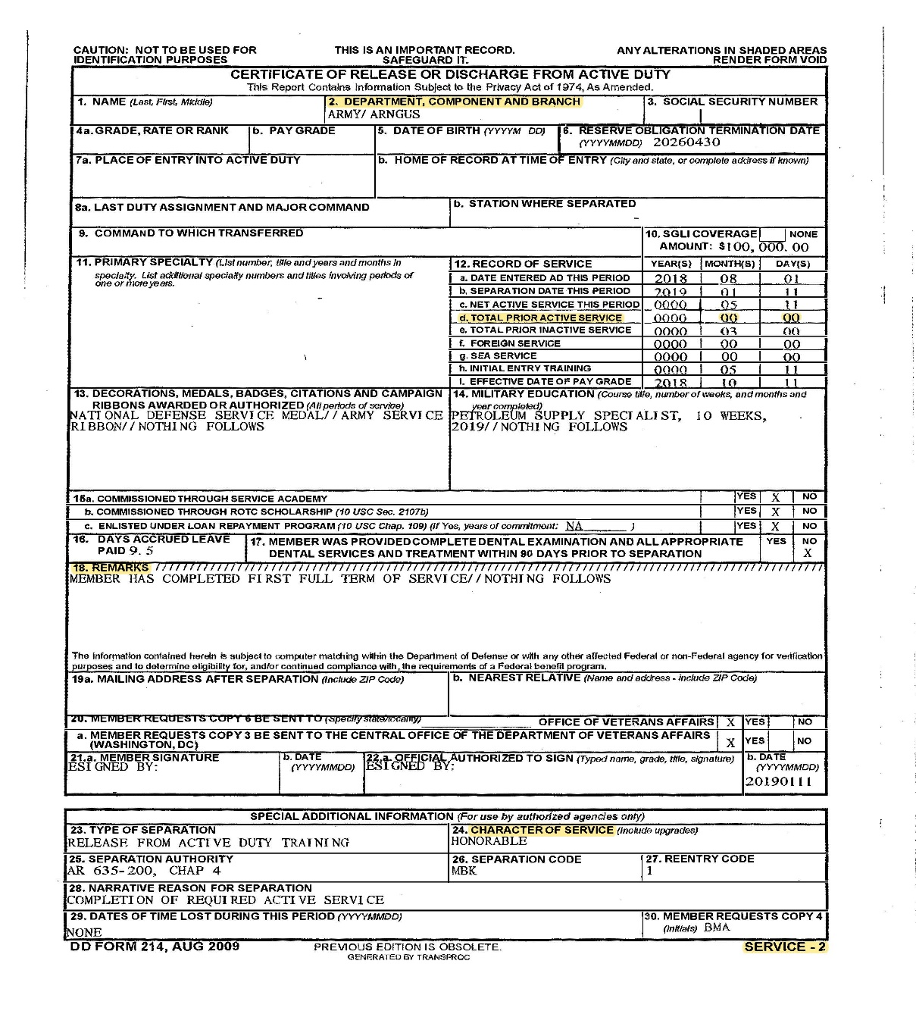
DD214 Example
Block 2:
Army – Air – Navy – Marines
Block 12d: Does it show all zeros?
Block 18: Does it state Title 10?
If not, you must provide T10 orders.
Block 24: Must state Honorable or Under Honorable Conditions
Service - 2, Member - 4, and Service - 7 show Block 24.

Slide 21
Leave & Absences
Common Types of Leave:
Annual
Sick
Military
Leave Balances can be found on your LES.
Other Types of Leave:
Court –for jury duty, witness, etc.
Administrative
Federal Holidays
New Year’s Day
Martin Luther King Day
Presidents’ Day
Memorial Day
Juneteenth
Independence Day
Labor Day
Columbus Day
Veterans Day
Thanksgiving Day
Christmas Day

Slide 22
Leave & Absences (Cont.)
Annual Leave
240 hours maximum carry over per calendar year.
Paid out in a lump sum if separated.
Temporary employees cannot use annual leave until they have been on board for 90 days.
Less then 3 years of service
4 hours per pay period
3 years but less than 15 years
6 hours per pay period
15 years or More
8 hours per pay period

Slide 23
Leave & Absences (Cont.)
Sick Leave
Earn 4 hours per pay period
No maximum carry over
May advance up to 240 hours (30 Days) for medical emergencies. Must be approved by supervisor and HR. You must provide medical documentation.
Sick leave balance stays as credit and will be reinstated, if you separate and return to Federal Gov.
If retiring from Federal Government, sick leave is converted into creditable service for annuity computation.
Notes:
Everyone earns sick leave.
Used for personal medical needs, care of a family member, adoption related purposes.
Everyone earns the same amount
May advance up to 30 days for medical emergencies this is with supervisor’s approval.
If separated, balance for sick leave stays as credit (only, annual is given in lump sum) will be reinstated if reemployed by Federal Government

Slide 24
Leave & Absences (Cont.)
Military Leave
Earn 120 hours per Fiscal Year (FY - Oct 01 through Sep 30)
Max of 240 hours carry over into next FY.
Balance will not show up on LES until it is used.
Temporary employees do not earn military leave unless their appointment is for 365 days or more.
Compensatory Leave (Comp Time)
Comp time is in lieu of overtime.
Title 32 does not authorize overtime pay.
Must be approved by your supervisor prior to working.
Must use within 1 year of duty being performed or will drop off.
Title 5 can get overtime pay in lieu of comp time, depending on FLSA status. Any time not used at 1 year expiration will pay out.
Notes:
TEMPORARY EMPLOYEE’S DO NOT EARN MILITARY LEAVE!
Earn 120 hours per Fiscal Year (01 OCT to 30 SEP) for the purpose of Active Duty, active duty for training, or Inactive Duty Training.
Can carry over a max of 240 hours into next FY; however your military leave cannot exceed 240 hours.

Slide 25
Leave & Absences (Cont.)
Disabled Veteran Leave
Covered under the Wounded Warriors Federal Leave Act of 2015 (Public Law 114-75, November 5th, 2015).
An employee hired on or after November 5, 2016.
Must also be a veteran with a service-connected disability rating of 30% or more from the Veterans Benefits Administration (VBA) of the Department of Veterans Affairs.
Is entitled to up to 104 hours of disabled veteran leave for the purposes of undergoing medical treatment for such disability.
**MUST CONTACT HR TO DETERMINE ELIGIBILITY**

Slide 26
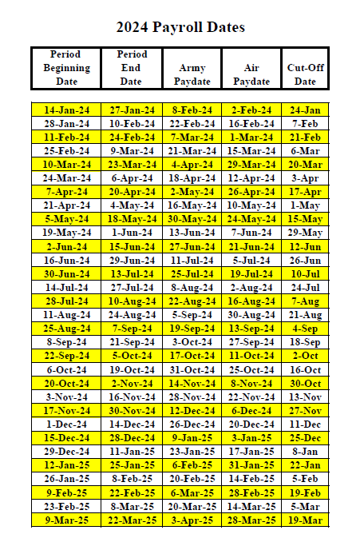
Pay Information
Pay periods start on Sundays and end on Saturdays.
Army pay dates are the 2nd Thursday after pay period ends.
Air pay dates are the 2nd Friday after pay period ends.
As a new employee it will take 4 weeks to receive your 1st paycheck.

Slide 27
Union
In accordance with Title 5 U.S.C. Section 7114(a)(3), the agency is required to inform its bargaining employees of the following:
You are entitled to Labor Organization representation, if you are subjected to any examination by a representative of the agency in connection with an investigation if:
1.) You believe the examination may result in disciplinary action
AND
2.) You request representation.
Labor Union Representatives are listed on Union bulletin boards at your work location, or you may contact Labor Relations, SFC Christina Depue christina.e.depue.mil@army.mil or (573) 638-9643

Slide 28
Worker’s Compensation
Report to your Supervisor:
Every related injury, illnesses or disease that is caused or aggravated by the employment should be reported to your supervisor.
Obtain Medical Care:
Complete an OSHA 301 and CA-1 or CA-2 via ECOMP either before receiving care, or after if immediate care is needed.
Do not use personal health insurance.
Note: Injury report will not be submitted to the Department of Labor unless there is incurred wage loss and medical payments.

Slide 29
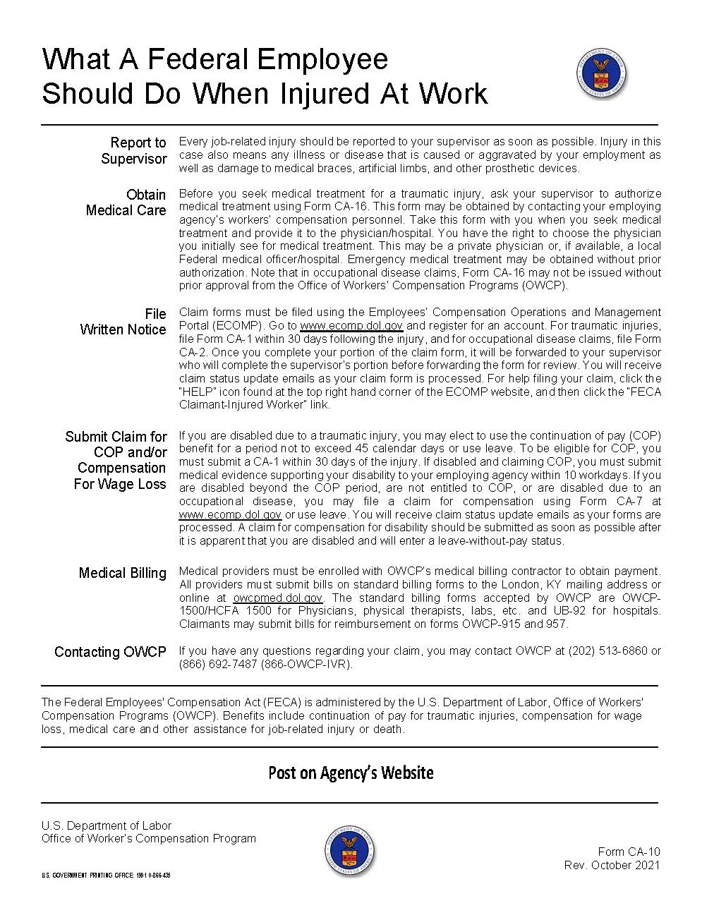
Worker’s Compensation (Cont.)

Slide 30
Inmates Working Relation
Inmate Work Release Program:
Inmate work relationship should be professional.
Inmates should not be provided with food, refreshments, money, stamps, letters or information.
Any unacceptable behavior should be reported to your supervisor.
Employees will not discriminate against an inmate basis of race, color, creed, national origin, ancestry, sex, age, or disability.
Employees will not write letters of recommendation or reference for inmates.

Slide 31
Inmates Working Relation (Cont.)
This policy does not cover all possible situations that can occur with such a relationship between the Office of the Adjutant General and the Department of Corrections. Any suspected violation should be reported to a supervisor immediately. Failure to follow these guidelines of this policy may result in disciplinary action.
Inmate incident/problem reports shown on this page, will be completed and forwarded using the most expeditious means possible when an incident occurs.
All new employees will receive training on conducting professional relationships with inmates in the Work Release Program.

Slide 32
Labor/Management Agreement
Official Record
Workweek and Hours of Work
EEO Program
Performance Appraisal System
Compensatory Time
TDY and Travel
Unfair Labor Practices
Employee Assistant Program
and More

Slide 33
Technician Handbook
Technician Handbook:
NGMO JFHQ Human Resources - Home (sharepoint-mil.us)
Contains valuable information: Pay Information, Leave and Absence, Performance Evaluation, Incentive Awards, FEGLI, FEHB, USERRA, Injury Compensation, Retirement, TSP, and other EEO issues.

Slide 34
MARKET PLACE.GOV
Beginning January 1st, 2014, the Affordable Care Act developed Marketplace.gov to;
Extend coverage to uninsured Americans.
Implement measures to lower health care costs
Improve system efficiency and eliminate industry practices that include recission and denial of coverage due to pre-existing conditions.
Reminder from the IRS: If you need health coverage, and to learn about health insurance options that are available for you and your family, how to purchase health insurance, and how you might qualify to get financial assistance with the cost of insurance, please visit:
Get 2023 health coverage. Health Insurance Marketplace® | HealthCare.gov
The Patient Protection and Affordable Care Act did not eliminate TCC or change the TCC rules.
Please go to this website: http://www.irs.gov/uac/Questions-and-Answers-on-the-Individual-Shared-Responsibility-Provision

Slide 35
FEHB Enrollment- Temporary Employees are Eligible
As of October 2014, certain employees on Temporary Appointments and Certain Employees on Seasonal and Intermittent Schedules, are eligible for FEHB.
Temporary employees on an appointments that exceed 90 days are eligible for FEHB from their date of hire.
Temporary employees that were initially ineligible for FEHB and then are extended beyond 90 days, become eligible for FEHB upon date of extension.

Slide 36
FEHB Enrollment- Temporary Employees are Eligible (Cont.)
Since Temporary Employees are eligible for FEHB if they are on board for 90 days or more, they cannot maintain another federal health insurance plan to include TRICARE Reserve Select.
You must contact a TRICARE representative to terminate coverage.
Click link for information to contact TRICARE:
TRICARE West (tricare-west.com)

Slide 37
FEHB Enrollment
As a new employee, you must make an election within 60 days of your 1st eligibility date or entrance on duty date.
You may make changes outside the 60 day window with a Qualifying Life Event (QLE) or during the annual Open Season.
A change in employment status is considered a QLE (e.g. from temporary to full-time)
Open Season begins the 2nd Monday in November and runs through the 2nd Monday in December effective on the 1st full pay period in January.

Slide 38
FEVIP Enrollment
As of July 25th, 2023, Office of Personnel Management (OPM) published the following changes to the federal regulation (5 CFR 894); expanding eligibility coverage:
Active-duty service members who become eligible for FEDVIP as uniformed service retirees pursuant to the National Defense Authorization Act of 2017.
Temporary employees on an appointment for 90 days or more, are eligible to enroll in FEDVIP within 60 days of hire.
Temporary employees who were hired prior to July 25th, 2023, and meet the appointment requirements, are eligible to enroll in FEDVIP during Open Season beginning November 13th, 2023.
Click the link to find and compare dental and vision plans:
Plan Selection | BENEFEDS
To enroll in a FEDVIP plan during your 60-day enrollment period, contact Benefeds at:
1-877-888-FEDS (1-877-888-3337) TTY 1-877-889-5680.
Customer Service Center is open Monday through Friday, from 9 a.m. to 7 p.m. (ET).

Slide 39
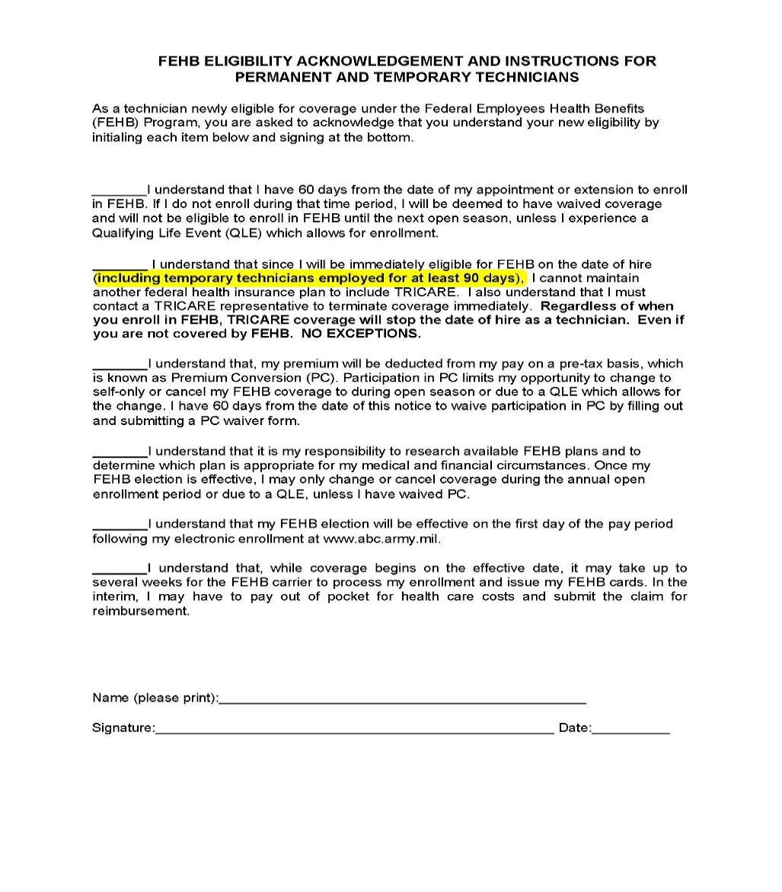
FEHB Eligibility Acknowledgment

Slide 40
OPM Website
Add website to Favorites, it provides useful informative information on:
Guide to Federal Benefits
Forms
USAJOBS
Retirement Information
Current updates from OPM
Federal Technician Handbook
and much more
Click the link to access OPM:
OPM Home - OPM.gov

Slide 41
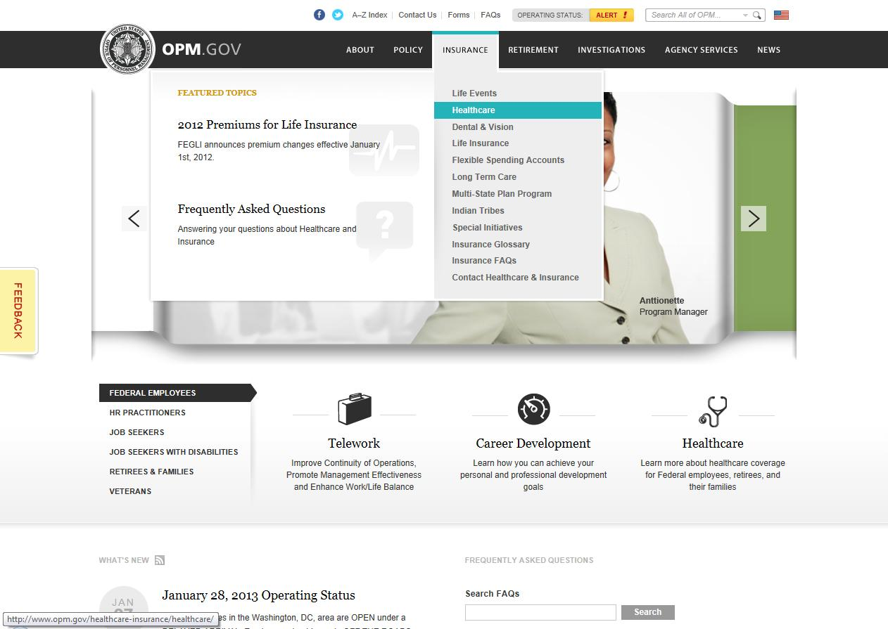
Compare FEHB Plans

Slide 42
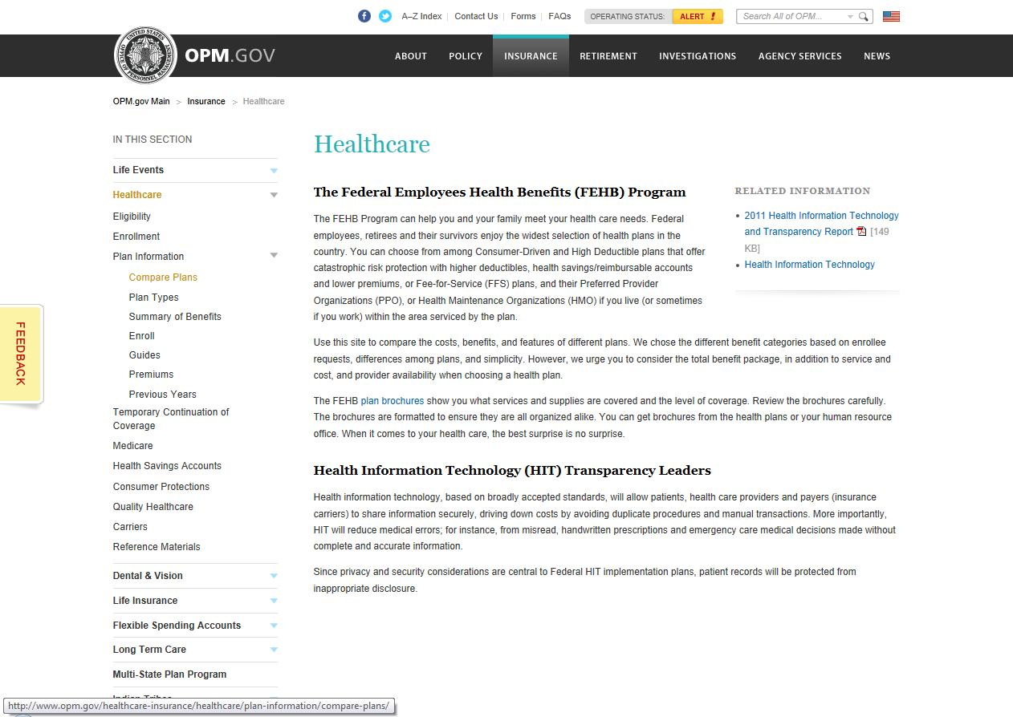
Compare FEHB Plans (Cont.)

Slide 43
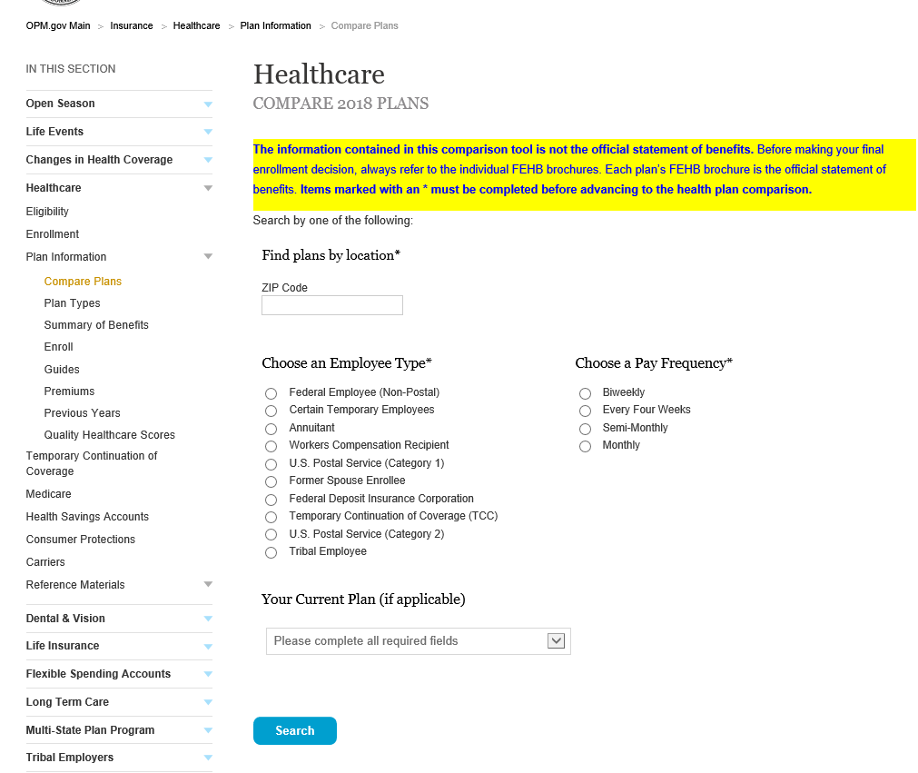
Compare FEHB Plans (Cont.)
Enter Zip Code for your area
Pay frequency
Fed Employee/Non-postal
And if you have a current plan—if not leave blank

Slide 44
Compare FEHB Plans (Cont.)

Slide 45
ABC-C/GRB Platform FEHB/FEGLI/TSP Enrollment https://abc.chra.army.mil/abc/

Slide 46
GRB Platform

Slide 47
GRB Platform (Cont.)

Slide 48
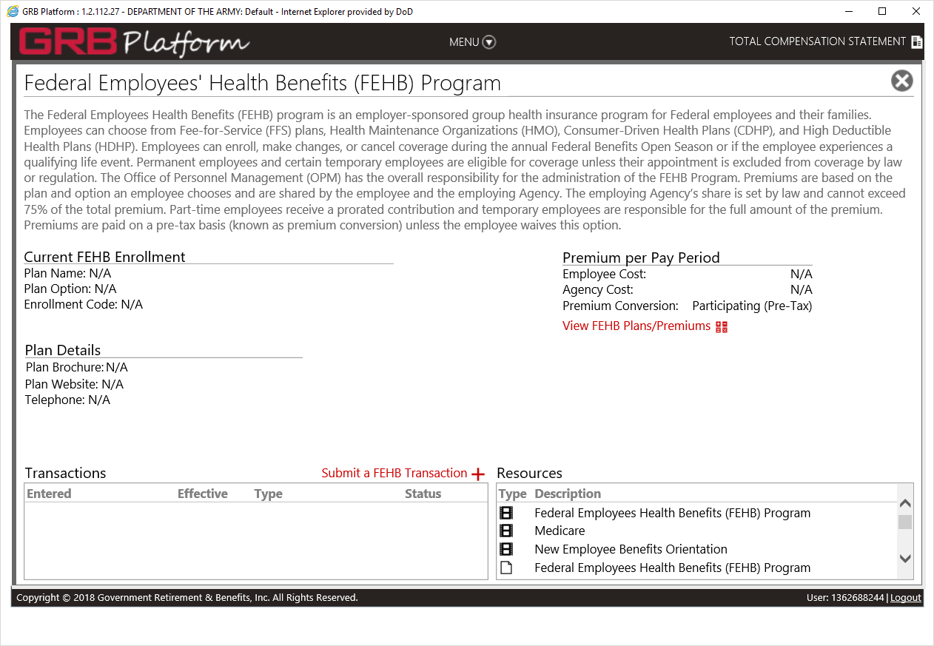
FEHB Transactions

Slide 49
FEHB Transaction (Cont.)

Slide 50
FEHB Transaction (Cont.)

Slide 51
FEHB Transaction (Cont.)

Slide 52
FEHB Transaction (Cont.)

Slide 53
FEHB Transaction (Cont.)

Slide 54
FEHB Transaction (Cont.)

Slide 55
FEHB Transaction (Cont.)

Slide 56
FEHB Transaction (Cont.)

Slide 57
Continue for Indefinite and Permanent Employees Only

Slide 58
Performance Appraisals
Within 30 days, your supervisor should provide you with your job objectives for your position.
Will have an interim review at 6 months.
Will have appraisal at 1 year.
After your 1st annual appraisal, your annual rating period will be Apr 1 through Mar 31.
It is very important that you have a Performance Appraisal completed every year. If a Performance Appraisal has not been completed within 5 years, it will affect your Within Grade Increase (WGI).
CNGBI 1400.25, Vol. 431 is the governing Regulation, and can be found at Benefits (ng.mil).
Performance Appraisal Questions, contact:
SFC Christina Depue christina.e.depue.mil@army.mil or (573) 638-9643.

Slide 59
Performance Appraisals
Click Performance to access your Performance Appraisal Application Main Page.

Slide 60
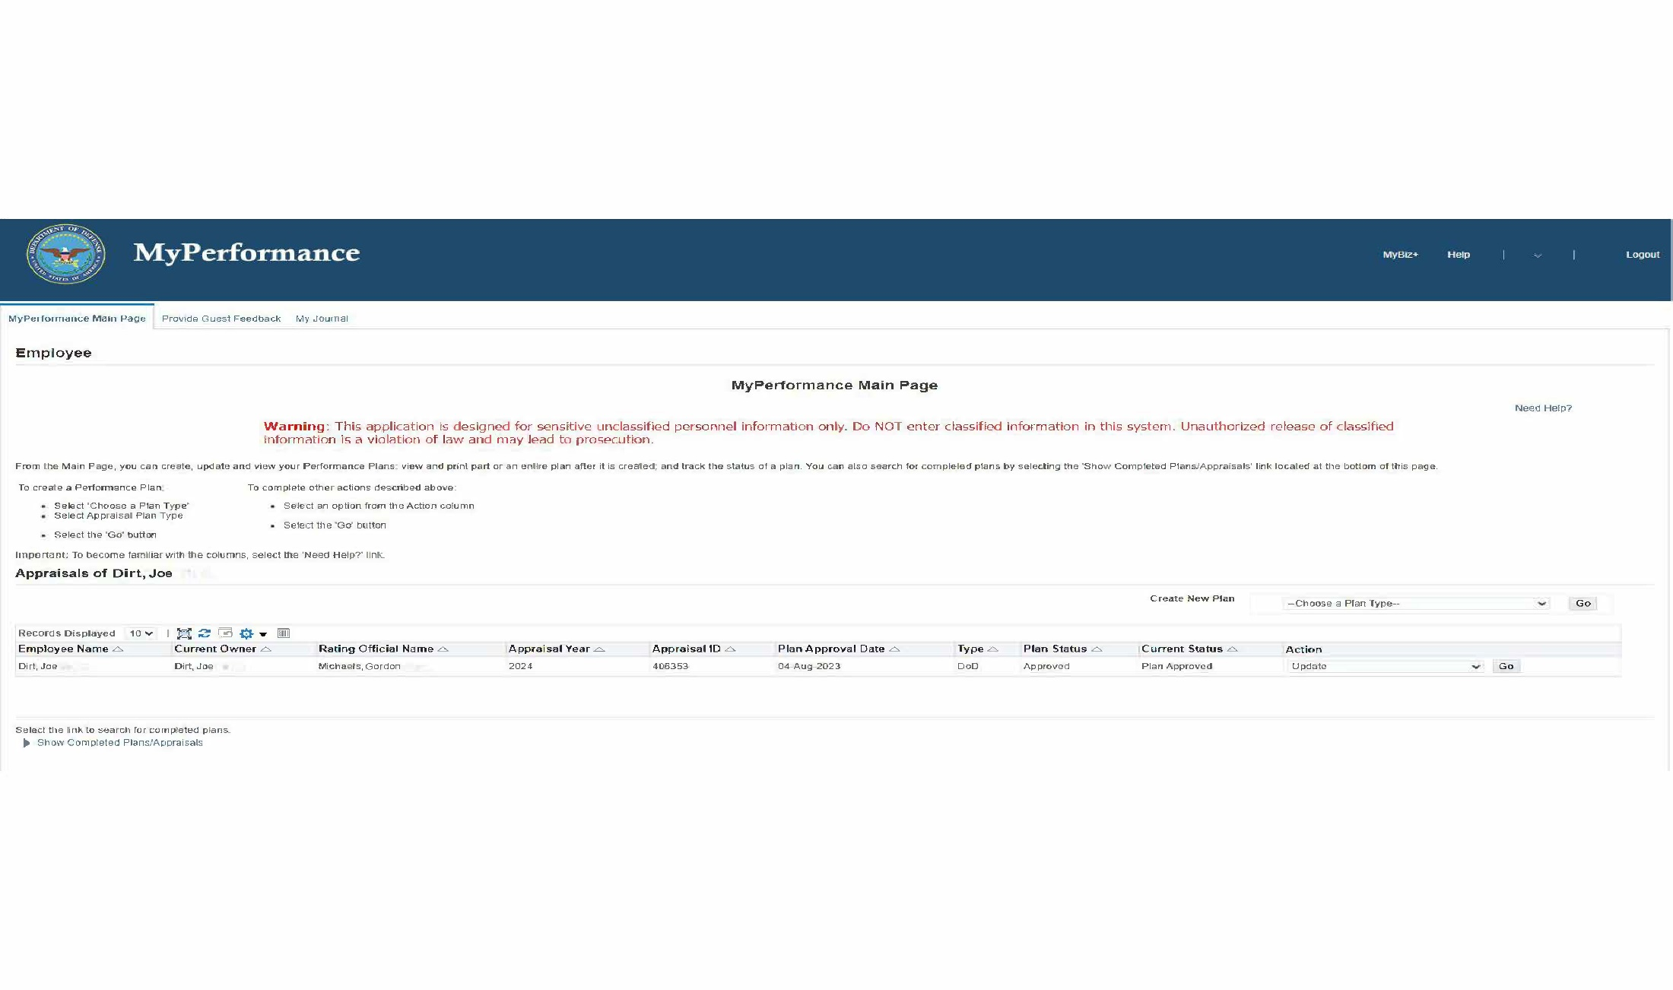
Performance Appraisal Application (PAA)
The Help link will give you information on what is available on the page where you are located.
You can log job tasks or special projects you have completed over the year, by click on My Journal.
This table includes information on the status of existing plans. From this screen you can view and update existing plans.

Slide 61
Military Deposit (FERS)
What is a Military Deposit?
Since you are covered by FERS, you are eligible to pay a deposit to obtain credit for your military service performed after December 31st, 1956. (You must contact the Human Resources Office to discuss which military service is creditable)
What happens if I do not buy back my Military Service?
Payment is Optional. You do not have to pay if you do not want to. Although, you will not receive any credit for it toward retirement, including your eligibility to receive an annuity and computing your average salary.
Interest accrues annually on the outstanding balance and is compounded annually until the outstanding balance is deposited, annuity, whichever is earlier.
How do I start a Military Deposit?
You may do so by emailing all Active-Duty Orders and DD214s to your Human Resources Office with Subject Line: Military Deposit.
For OPM to grant active-duty military service credit under the CSRS or FERS retirement systems, the employee must provide proof of honorable service, type of active-duty service and the active-duty dates.
Do I have to have my Military Deposit paid in full prior to separating?
Military service deposits must be paid in full prior to the date of separation for retirement.

Slide 62
Military Deposit (FERS) (Cont.)
How soon can I retire or separate after buying back my time?
Employees should allow a minimum of 180 days processing time prior to their anticipated date of retirement to ensure that payment is posted prior to their separation.
Employees who are anticipating retirement in the next 6 months and who wish to pay their military service deposit(s) should initiate the process immediately.
Once military deposits have been paid in full you are responsible to forward that paid military deposit receipts the Human Resource Office, so that a Paid In Full letter can be requested from DFAS.
ABC-C processes all non-USERRA Post 56 Military Deposits:
Title 10
Prior to technician or Title 5 service
HRO processes all USERRA Post 56 Military Deposits:
Title 10 or Title 32
Interrupts civilian Federal service
Sign the Acknowledgment Form included in the New Hire Packet

Slide 63
Military Deposit (FERS) (Cont.)
Questions on military service deposits and the process for initiating them may be directed to the Army Benefits Center – Civilian (ABC-C) at 877-276-9287 between the hours of 6:00 AM and 6:00 PM Central Time to speak with a retirement counselor.
Instructions for initiating the military service deposit process are also available on the ABC-C website, CHRA Knowledge Home - ABC-C (army.mil)
You may also contact Leigh Ann Smith with the Human Resources, Employee Benefits Office leigh.a.smith62.civ@army.mil or 573-638-9892

Slide 64
FEGLI
Automatically enrolled in Basic.
You must maintain Basic to elect Optional Coverage.
Elections can be made through the GRB Platform website or using the automated telephone system.
You may only increase coverage within first 60 days of employment, during a Qualifying Life Event (QLE), during Open Season, or when you pass a physical exam (Option C excluded).
You may waive or decrease your coverage at any time.
Notify ABC-C immediately if your FEGLI coverage is not correct on your LES.

Slide 65
FEGLI Coverage
Basic
Annual Salary rounded up to nearest thousand + $2,000
Option A – Standard
Basic + 10,000
Option B – Additional
1,2,3,4, or 5 multiples of your Annual Salary
Option C – Family
1,2,3,4, or 5 multiples
$5,000-Spouse * Multiple Selected
$2,500-Eligible Dependent * Multiple Selected

Slide 66
FERS
FERS
Retirement Plan
BASIC BENEFIT PLAN
Contribution – 4.4% of your salary
SOCIAL SECURITY BENEFITS
OASDI (Old Age Survivors, and Disability Insurance) -6.2% of your earnings up to the maximum taxable wage base
Medicare- 1.45% of your total pay
THRIFT SAVINGS PLAN (TSP)
Agency automatically contributes 1% of your salary
Agency matches your contributions up to 5% of your salary

Slide 67
TSP Highlights
You are Automatically enrolled in a Traditional account at 5% of your basic pay.
You have Traditional or Roth Investment Options
The agency automatically contributes 1%, and matches you up to 5%.
The agency contributions will always be Traditional.
You may Increase or Decrease your contribution amount at any time (changes take effect at the beginning of the following pay period).
Enrollment/changes are done through GRB Platform.
Click link below:
GRB Platform ABC-C - ABC-C (army.mil)

Slide 68
Smart Savings Act
As of September 5th 2015, the investments of all newly enrolled civilian TSP participants and beneficiary participants, are automatically placed in an age-appropriate Lifecycle (L) Fund.
This change was in accordance with the Public Law 113-255, the Smart Savings Act, signed into law on December 18th, 2014, by President Barack Obama.
Click the link for more information:
Smart Savings Act: New Default Investment Fund for Civilian and Beneficiary TSP Participants | The Thrift Savings Plan (TSP)
Average Annual Returns (As of 30 June 2023)
 | L 2040 Fund*
1-Year | 14.49%
3-Year | 9.17%
5-Year | 7.24%
10-Year | 8.22%
Since August 1st, 2005 | 7.13% | *After expenses

Slide 69
TSP Investment Funds
Lifecycle Funds:
The following 10 L Funds are a diversified mix of these 5 individual funds (G, F, C, S, and I).
These funds were designed to allow you to invest your entire contributions into a single L Fund, resulting in the best expected return for the amount of expected risk that is appropriate for you.
Every 3 months, the target allocations of all L Funds except L Income are automatically adjusted, shifting from higher risk to lower risk, as you get closer to your retirement date.
Click the link for more information:
Lifecycle Funds | The Thrift Savings Plan (TSP)
Lifecycle Funds
L Income
L 2025
L 2030
L 2035
L 2040
L 2045
L 2050
L 2055
L 2060
L 2065

Slide 70
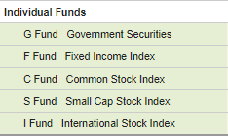
TSP Investment Funds (Cont.)
Individual TSP Funds (G, F, C, S, and I):
The individual TSP funds include a short-term U.S. Treasury security and index funds that are made up of stocks and bonds.
To move your TSP contributions from one individual TSP fund to another, you must log onto: www.TSP.gov
Click link for more information:
Individual Funds | The Thrift Savings Plan (TSP)

Slide 71
TSP Investment Funds (Cont.)
Mutual Fund Window:
Designed to give you more investment flexibility.
Gives you the ability to transfer money from your TSP account, through the mutual fund window, and open a separate investment account provided by TSP’s mutual fund window vendor.
Gives you the ability to buy, sell, and exchange from available mutual funds.
Must meet the below eligibility requirements and pay the necessary fees:
Your 1st transfer to the mutual fund window must be $10,000 or more, but may not be more than 25% of your total TSP savings.
You must have a minimum of $40,000 in your TSP account to ensure your 1st transfer is not more than 25% of your TSP savings.
You may not invest more than 25% of your total account balance in the mutual fund window at any time.
Click the link below for more information:
Mutual Fund Window | The Thrift Savings Plan (TSP)

Slide 72
TSP Matching
FERS EMPLOYEE | AGENCY AUTOMATIC | AGENCY MATCHING | TOTAL TSP
0%* | 1% | 0% | 1%
1%* | 1% | 1% | 3%
2%* | 1% | 2% | 5%
3%* | 1% | 3% | 7%
4%* | 1% | 3.5%** | 8.5%
5%* | 1% | 4%** | 10%
Percent of base salary.
Match dollar for dollar on 1st 3% then 50 cents on the dollar for the next 2%.

Slide 73
TSP Handbook
Contributing to the TSP
Contributions Limits
Tax Advantages
Tax Liability
Moving Money from Other Plans into the TSP
Investing in the TSP
TSP Loans and Withdrawals
Death Benefits
Other Information about the TSP
Click the link for more information:
Summary of the Thrift Savings Plan: tspbk08.pdf

Slide 74
FSAFEDS
What is FSAFEDS?
A tax-favored program that allows employees to pay for eligible out-of-pocket health care and dependent care expenses with pre-tax dollars.
THREE TYPES:
Health Care FSA
Dependent care FSA
Limited Expense (w/HD Plans)
For more information visit: www.opm.gov. For technicians interested in enrolling in this program, visit FSAFEDS.com.
It is important to keep in mind that if you don’t use your money, you lose it.
Grace Period for DCFSA
Carry over up to $610 for HCFSA
(Note: It is completely voluntary)
Clink the link for more information:
www.FSAFEDS.com

Slide 75
FSAFEDS
Annual Tax Savings Example | With FSA | Without FSA
If your taxable income is: | $50,000 | $50,000
And you deposit this amount into an FSA: | $2,000 | -$0-
Your taxable income is now: | $48,000 | $50,000
Subtract Federal & Social Security taxes: | $13,807 | $14,383
If you spend after-tax dollars for expenses: | -$0- | $2,000
Your real spendable income is: | $34,193 | $33,617
Your tax savings: | $576 | -$0-
Note: This example is intended to demonstrate a typical tax savings based on 27% Federal and 7.65% FICA taxes. Actual savings will vary based upon the retirement system in which you are enrolled (CSRS or FERS), your state of residence, and your individual tax situation. In this example, the individual received $2,000 in services for $1,424 - a discount of almost 36%. You may also wish to consult a tax professional for more information on the tax implications of an FSA.

Slide 76
Example of Reimbursements Eligible Expenses Juke Box (full list)
Condition/Type of Service/Expense | Account Type | Eligible Expense | Remarks
AMBULANCE | HCFSA | X | ----
ALCOHOLISM/DRUG/SUBSTANCE ABUSE TREATMENT | HCFSA | X | Inpatient treatment, outpatient care, transportation
BAN-AIDS/BANDAGES | HCFSA | X
BEFORE AND AFTER-SCHOOL CARE | DCFSA | X | Child must be under 13 or one who is incapable of self care and can be claimed on your Federal Income Tax Return.
CAMPS, summer or holiday (Day) | DCFSA | X | Child must be under 13 or one who is incapable of self care and can be claimed on your Federal Income Tax Return. Payment in advance is not covered. You can only be reimbursed for expenses that have been incurred
CONTACT-LENSES | HCFSA LEX HCFSA | X | Contact lenses, cleaning and soaking solutions and lens storage cases are all eligible for reimbursement

Slide 77
FEDVIP
Federal Employees Dental and Vision Insurance Program:
is a voluntary, enrollee-pay-all dental and vision program. Office of Personnel
Management (OPM) offers eligible participants a choice between 12 dental and
5 vision carriers.
Eligible employees who are interested in enrolling into FEDVIP must enroll
within 60 days of hire.
Click the link to find and compare dental and vision plans:
Plan Selection | BENEFEDS
Click the link below for more information and to enroll:
Plan Selection | BENEFEDS

Slide 78
NGAUS Insurance Federal Long-Term Disability Insurance & Term Life Insurance Plan
Long Term Disability Insurance
Depending on your salary you may receive $1,100 per month from the Basic Disability.
Term Life Insurance
Each individual is limited to a maximum of $250,000 term life insurance coverage under all NGAUS Insurance Plans through ReliaStar Life Insurance Company.
Note: Please review Limitations/Exclusions on both insurances before submitting the NGAUS Insurance Program form.

Slide 79
NGAUS Insurance (Cont.)
This coverage replaces about 60% of technician’s income, should the technician become sick or injured and cannot work. This is offered through payroll deductions, providing a safety net for technicians and their families.
Beginning July 1st, 2023, new hires can enroll in NGAUS Insurance and pay nothing for 12 months, when they enroll within the first 31 days of hire.
Should you have any questions, please contact Luke Guthrie from the Insurance Trust at: (800) 642-8748.
Click the link below for more information:
www.ngaus.org/insurance

Slide 80
Federal Long-Term Care Insurance Program (FLTCIP)
Long-term care assists with daily living (such as eating, dressing and bathing) that someone may need due; chronic illness, injury, disability, or aging.
This long-term care insurance program covers; Federal employees, spouse, parents, parents-in-law, step-parents and adult children (including adopted or step-children) of living employee.
Click the link for more information and enrollment:
LTCFEDS | The Federal Long Term Care Insurance Program (FLTCIP)
As of December 19th, 2022 federal employees not currently enrolled may not apply for coverage, and current enrollees may not apply to increase their coverage. The suspension will remain in effect for 24 months, unless OPM issues a subsequent notice to end or extend the suspension period.

Slide 81
Benefits Links
Benefit Programs: | # of Days Employee Has to Enroll from Date of Hire: | Where to go to Enroll in Programs: | Website/Form Where Additional Information Can Be Found:
FEHB (Federal Employees Health Benefits) | 60 Days | GRB Platform | www.opm.gov https://abc.chra.army.mil/abc/
FEGLI (Federal Employee Group Life Insurance) | 60 Days | GRB Platform | www.opm.gov https://abc.chra.army.mil/abc/
TSP (Thrift Savings Plan) | N/A | GRB Platform | www.opm.gov/healthcare-insurance/flexible-spending-accounts/
FSAFEDS (Flexible Spending Account) | 60 Days (Unless start after 1 Oct, then wait for next Open Season) | www.fsafeds.com | www.tsp.gov https://abc.chra.army.mil/abc/
FEDVIP (Federal Employee Dental and Vision Insurance Program) | 60 Days | www.benefeds.com | www.opm.gov/healthcare-insurance/dental-vision/
FLTCIP (Federal Long Term Care Insurance Plan) | 60 Days | www.ltcfeds.com | www.opm.gov/healthcare-insurance/long-term-care/
NGAUS (Technician Insurance Program) | 60 Days | Submit NGAUS-APPMN to HR | www.naugus.org

